Slide 1
Investigative Journalism in Botswana
Ntibinyane Ntibinyane – Investigative Reporter ,

Slide 2
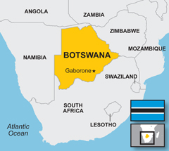

Slide 3
Introduction
Botswana
Gained independence from Britain in 1966
Africa’s success story
GDP per capita U$70 per year now is around U$17 000 per year.
One of the richest African countries,

Slide 4
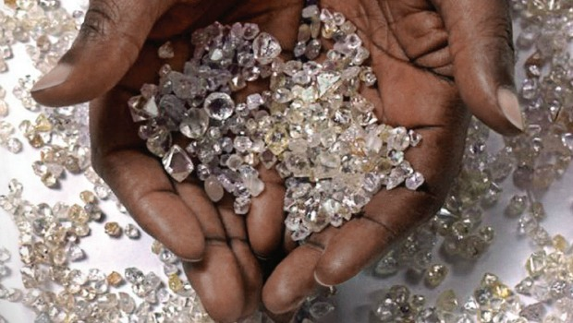
What led to the economic success?
Discovery Diamonds

Slide 5
What led to the economic success? Con’td …
Diamonds (and other mineral resources) discovered in the early 1970s
More than 5 diamond mines discovered
50%-50% partnership with De Beers Mining company
At one point diamonds accounted to more than 80% of the national budget
With diamonds proceeds government introduced free social programmes
Free education
Free health care

Slide 6
Political Stability
Political stability meant that the country was able to do well economically
Never had military coup or any kind of political instability.
Botswana a multi-party democracy even though the ruling party has won every single election since 1966

Slide 7
Fighting Corruption and holding power to account
Botswana no longer a shining example of democracy
Weak oversight bodies and anti-corruption agencies
Lack of independence from the executive
Failure to investigate top officials

Slide 8
The Role of Investigative Reporters in fighting corruption
Lack of strong oversight bodies now means that the role of fighting corruption rests on investigative journalists
Print media at the fore front of the fight against corruption
State media spew government propaganda

Slide 9
Challenges faced by investigative reporters

Slide 10
Challenges faced by investigative reporters
Government roadblocks
Lack of access to information laws
Lack of declaration of assets and liabilities laws
Media Practitioners Act
Institutional Challenges
Lack of training
Investigative journalism units/desks

Slide 11
Starting an Investigative Journalism Centre
The centre’s primary roles
Investigative stories
Training
Advocacy

Slide 12
Major Stories
Exposed Business Interests of the three Botswana Presidents in South Africa
Sir Ketumile Masire
Festus Mogae
Ian Khama

Slide 13
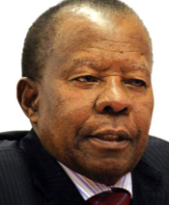
SIR KETUMILE MASIRE (1980 -1998
Using SA company searches and other investigative tools we established the following;
Masire was chairman of a ponzi scheme company that robbed investors R70 million
In partnership with dodgy individuals
Investigators recommended that Masire and Co be prosecuted
SA government refused to prosecute

Slide 14
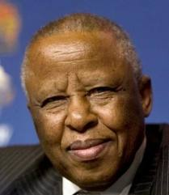
FESTUS MOGAE (1998 – 2008)
Jonah Capital
In 2008 months before he left the presidency his administration awarded coal mining licenses to a company called Jonah Capital
Later joined the company as director
SHRENUJ
In 2006 Recruits Indian diamond jeweler company to Botswana
2012 joins the company as Director

Slide 15
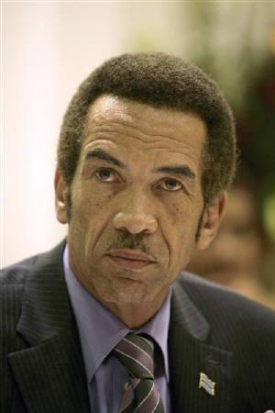
IAN KHAMA (2008 -
His government pushed out an indigenous tribe from their ancestral place
The place was later occupied by a Tourism company linked to the president and his family
Established that he was a shareholder at the company
We revealed that his nephew and personal lawyer are directors of the company

Slide 16
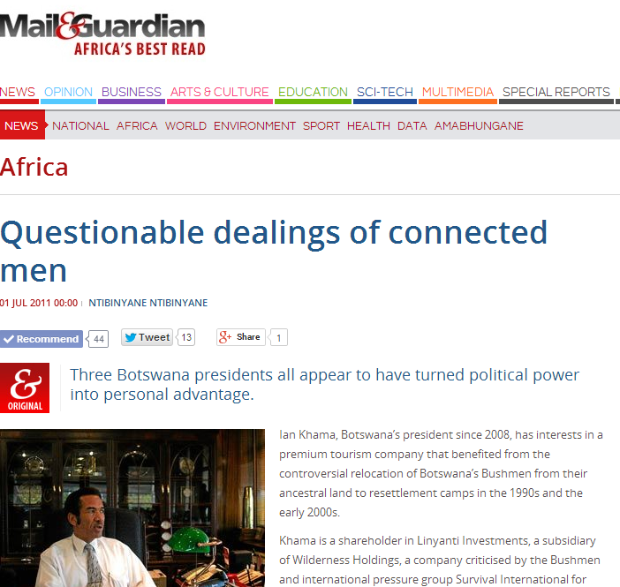

Slide 17
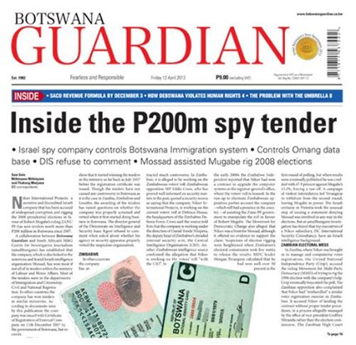
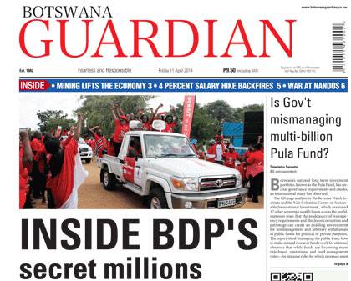
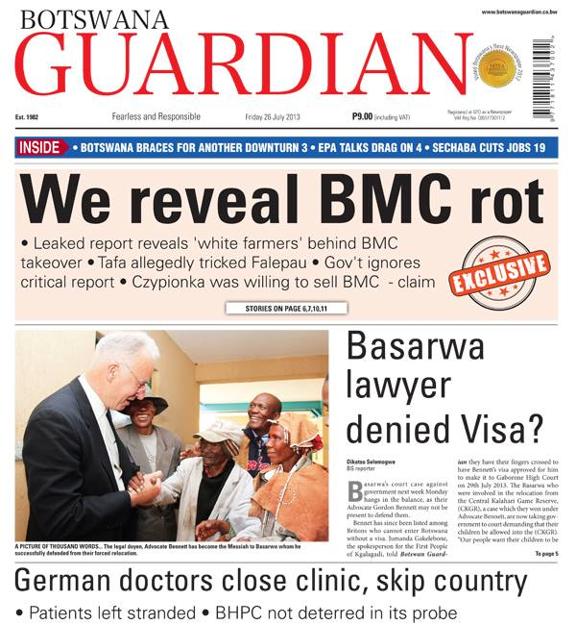

Slide 18
THANK YOU

